Slide 1

Unlocking Insights from the IMDB Dataset
KARTHICK.T
RP-33

Slide 2

INTRODUCTION
To extract actionable insights
Helps for strategic decision-making in the film industry.
This includes understanding audience preferences.
Identifying trends in movie production.
Evaluating the performance of actors and directors
Stakeholders can enhance the quality, profitability, and global appeal of their film projects.

Slide 3

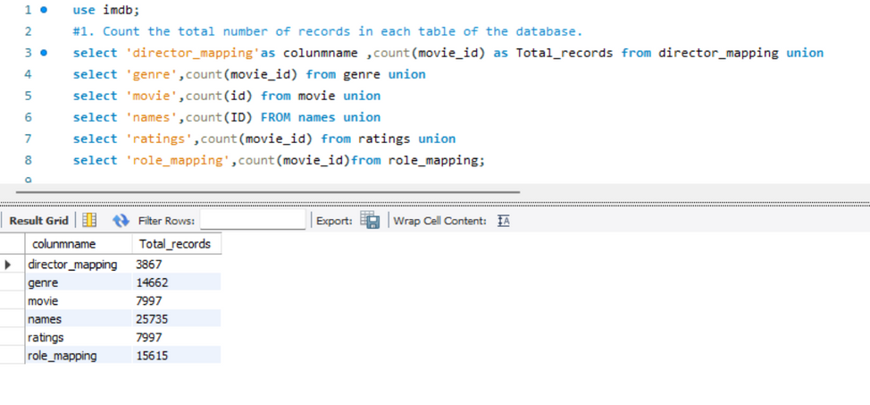
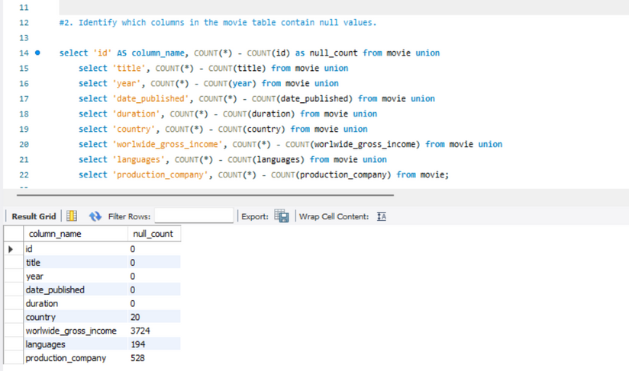
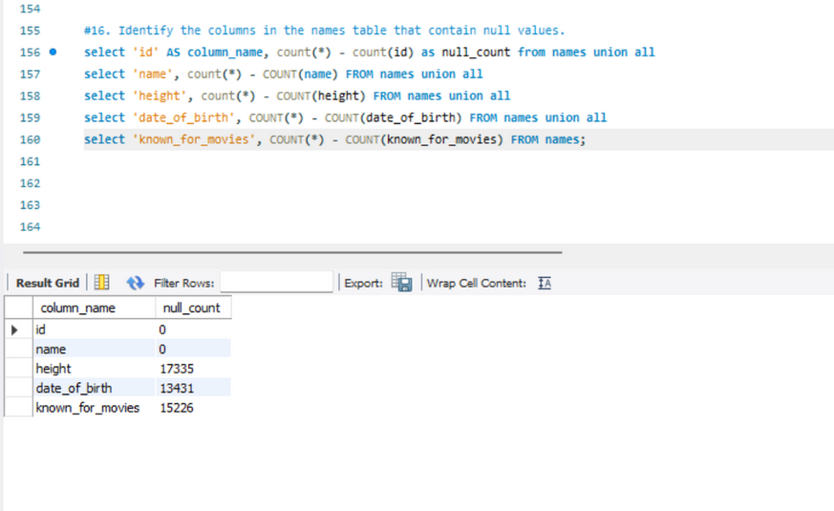
1. Data Exploration and
QualityChecks
Count the total number of records in each table.
Find Null value in Which Table.
Identify columns in the movie & names
table with null values.
Ensure data integrity and identify areas for improvement in data collection.

Slide 4
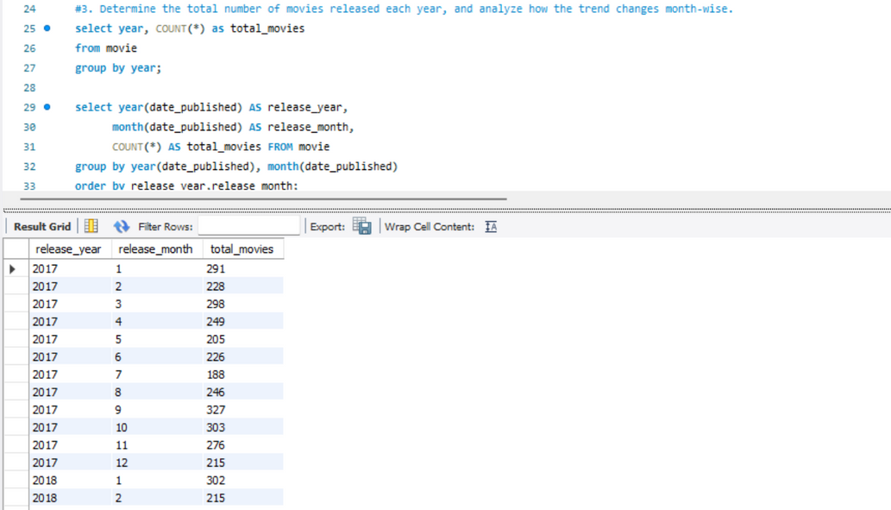
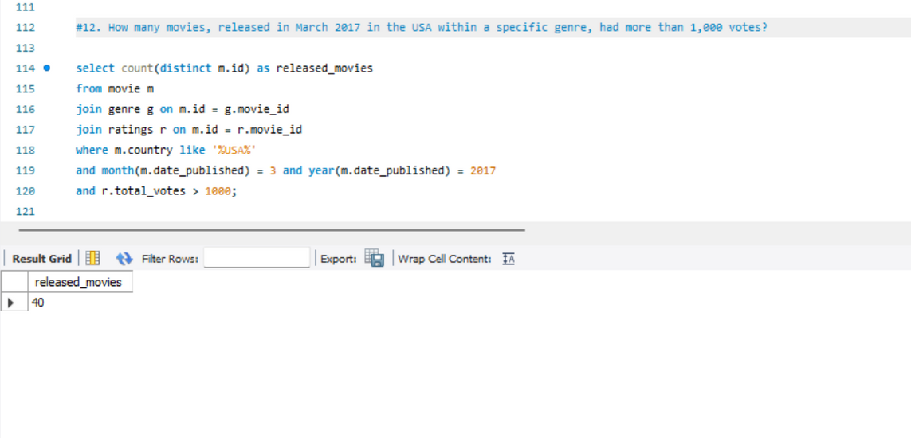
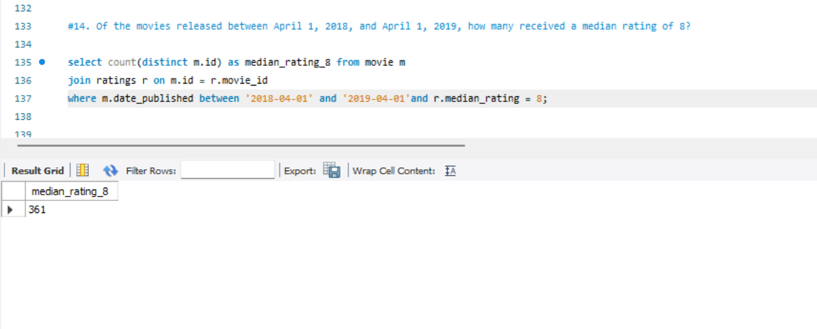
2. Movie Release Trends
The total number of movies released each year and analyze monthly trends.
Movies released in March 2017
movies released between April 1, 2018, and April 1, 2019.
Seasonal trends and optimize release schedules.

Slide 5
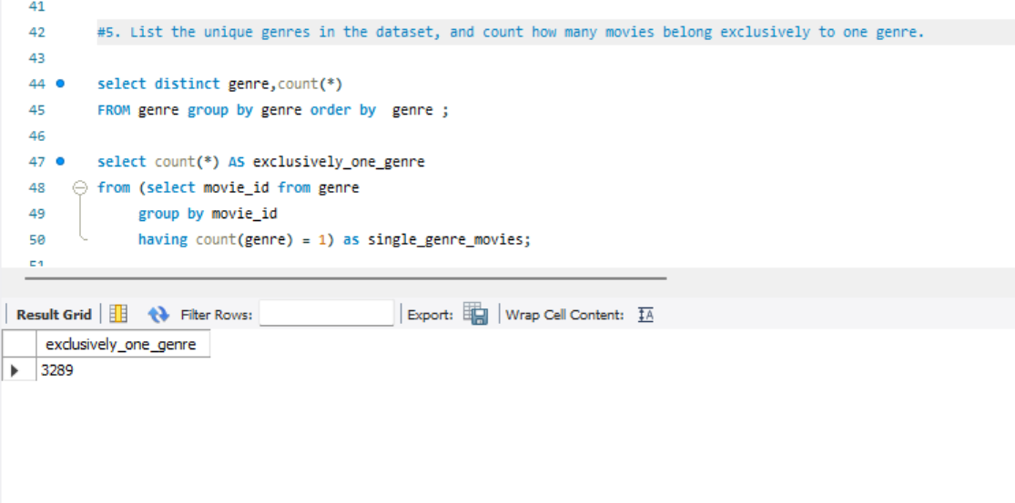
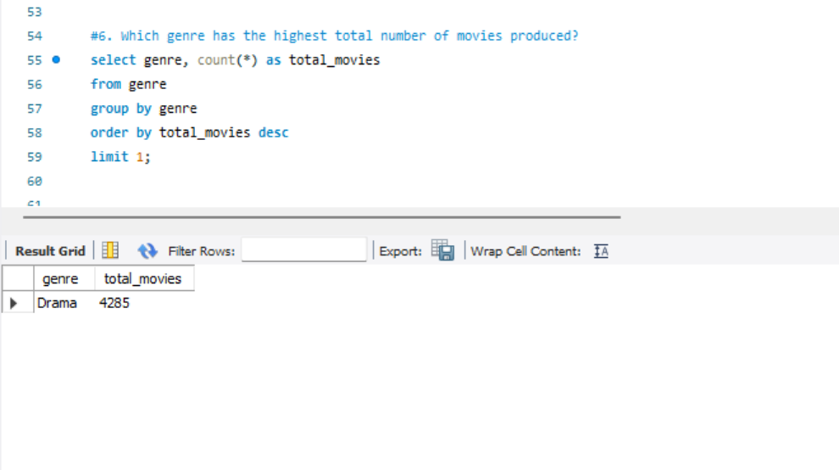
3. Genre Analysis
Unique genres and count movies belonging exclusively to one genre.
Count of Exclusively One Genre - 3286.
Highest number of movies produced.
Genre : Drama - 4285

Slide 6
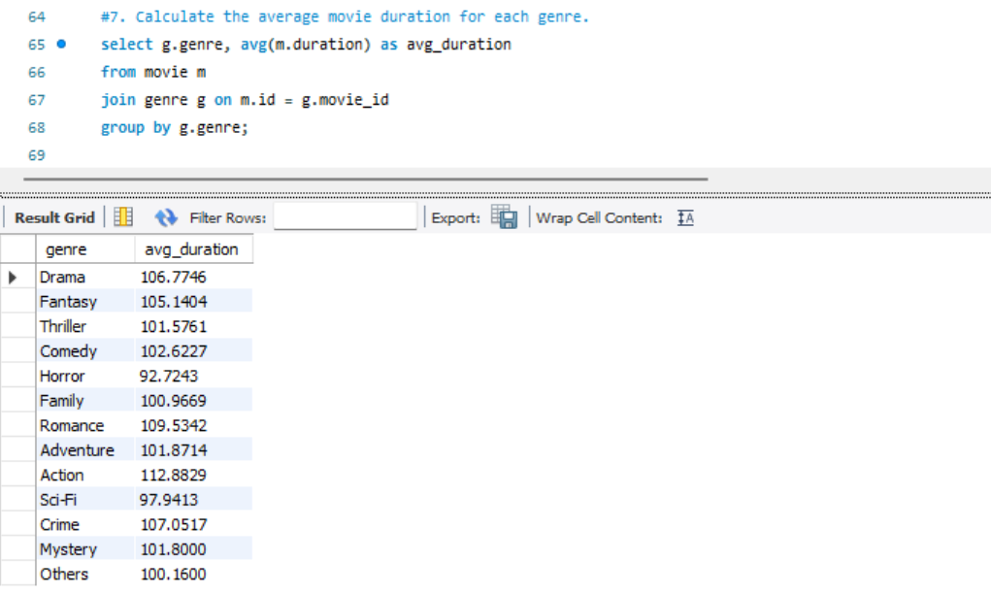
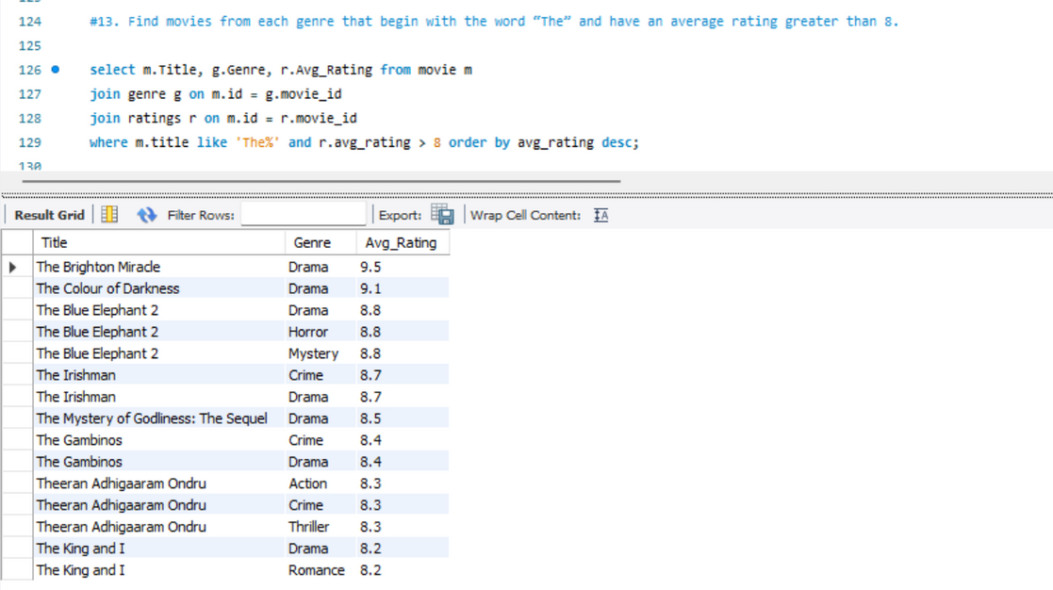
3.1 Genre Analysis
Average movie duration for each genre
Movies from each genre that start with "The"
Understand genre popularity and guide production decisions.

Slide 7
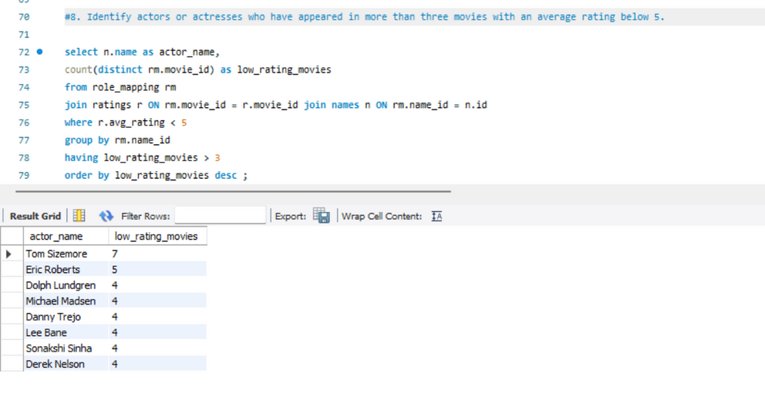
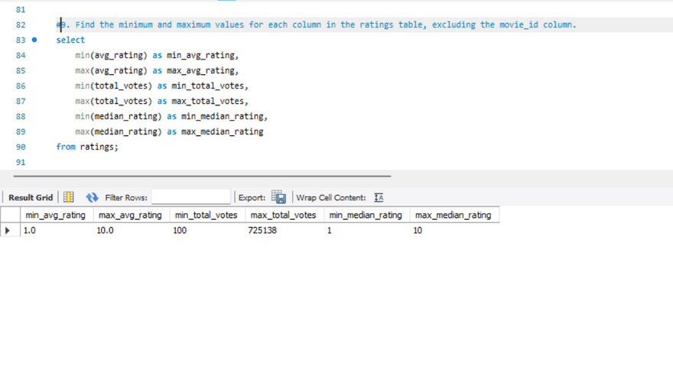
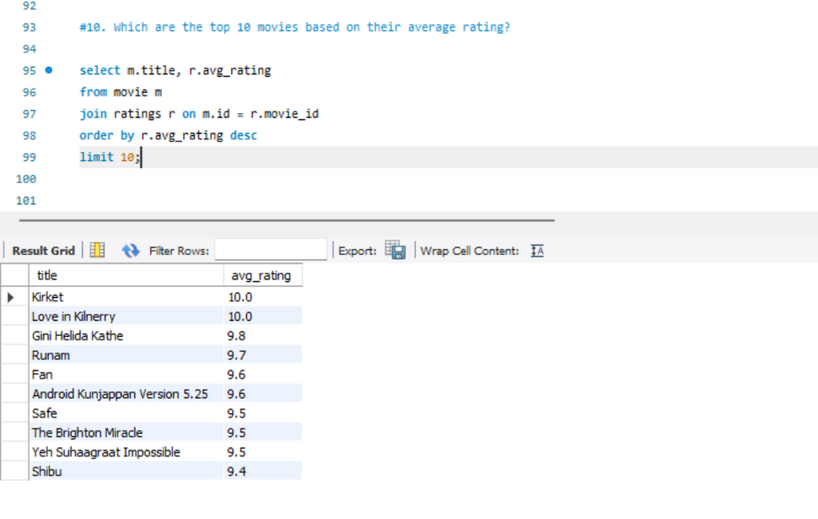
4. Ratings and Audience Engagement
Actors/actresses in >3 movies with an average rating <5.
Min/Max values for columns in the Ratings table.
Top 10 movies based on average rating.

Slide 8
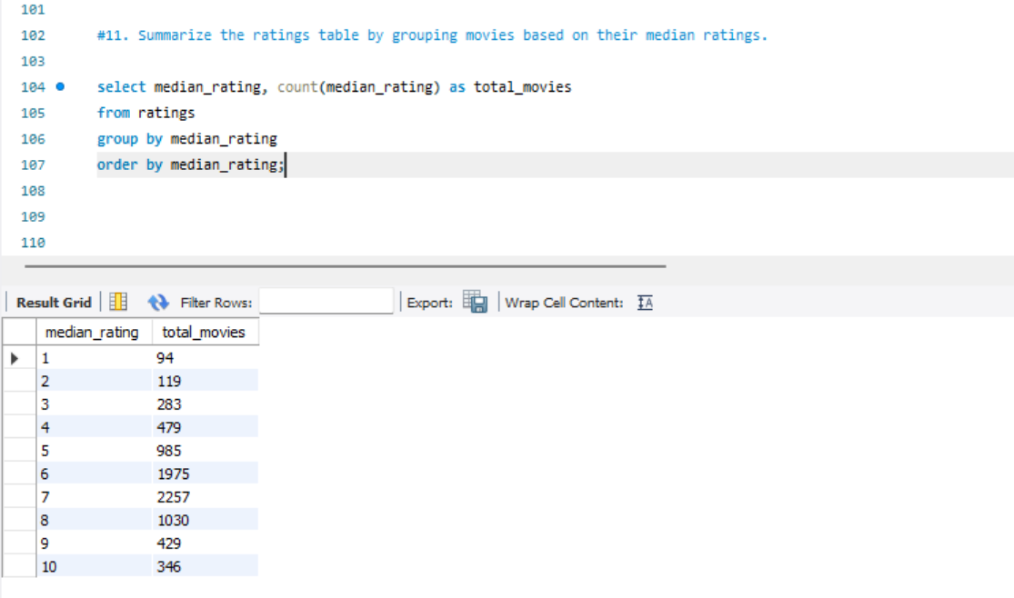
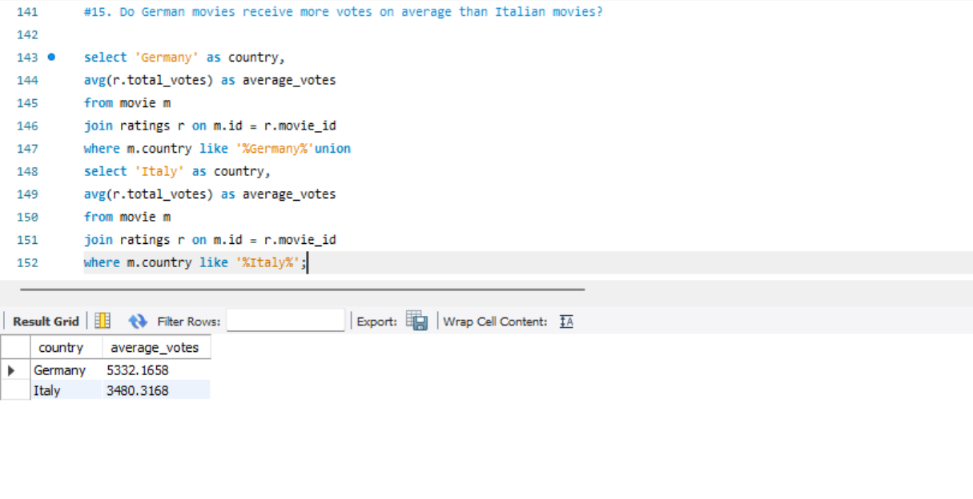
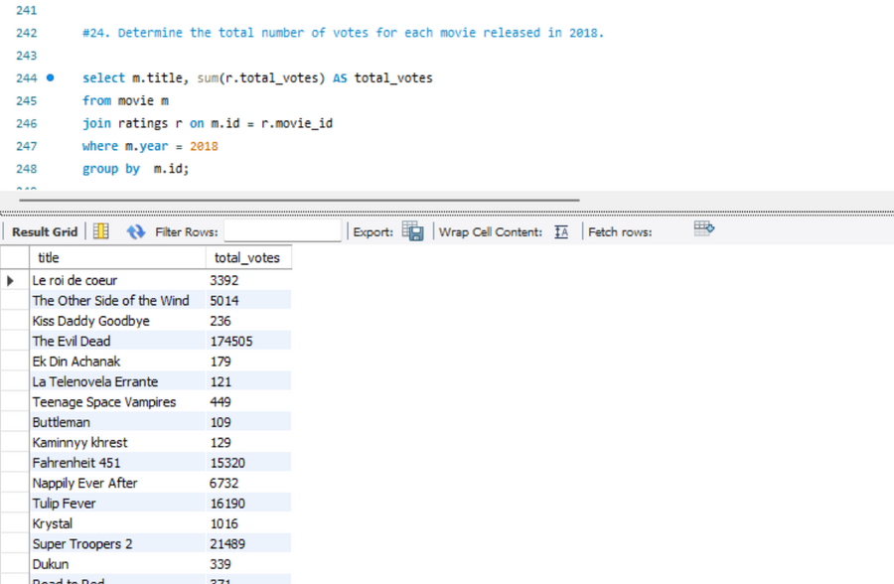
4.1 Ratings and Audience Engagement
The ratings table by grouping movies based on median ratings.
Compare average votes for German and Italian movies.
The total number of votes for movies released in 2018.

Slide 9
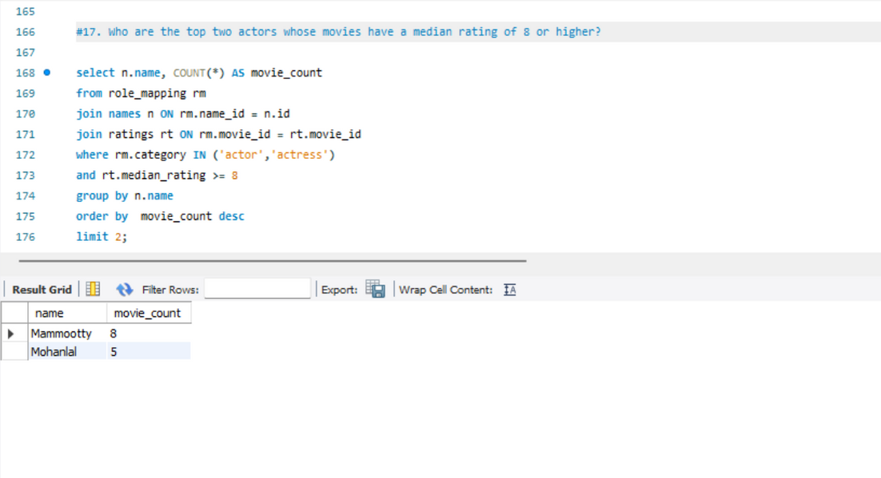
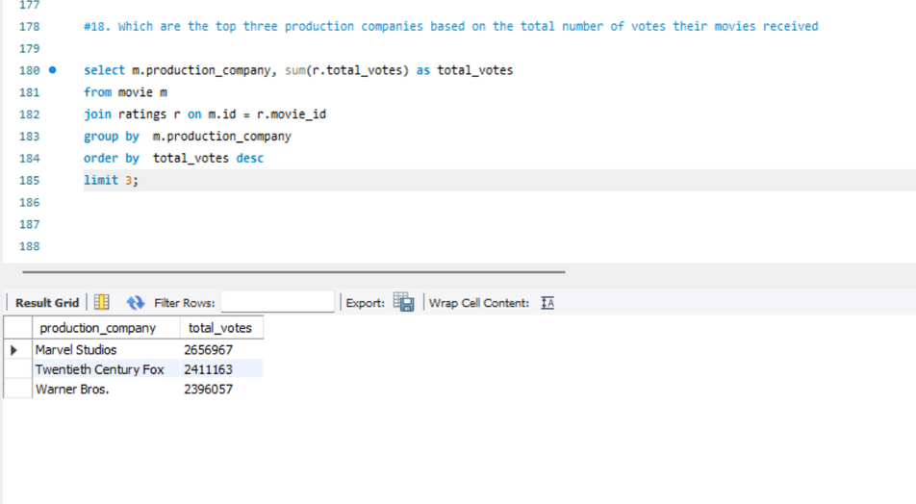
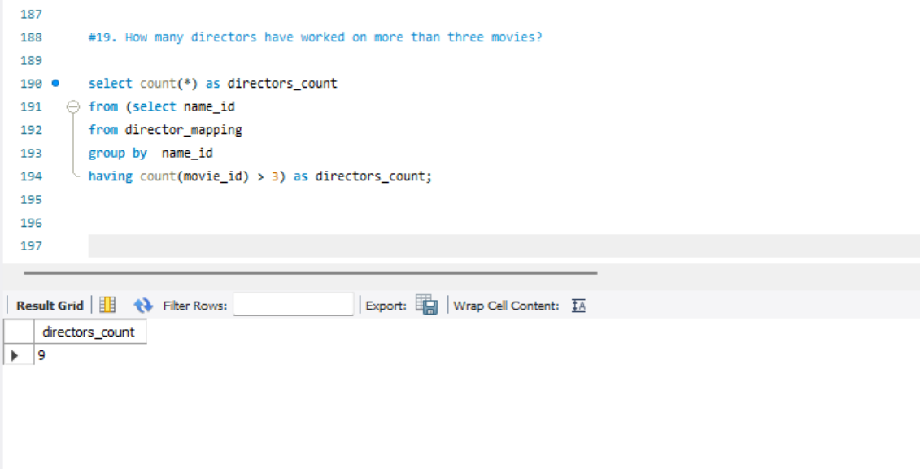
5. Talent and Production Analysis
Top 2 actors with movies having a median rating ≥8.
The top 3 production companies based on total votes.
Count directors who have worked on >3 movies.

Slide 10
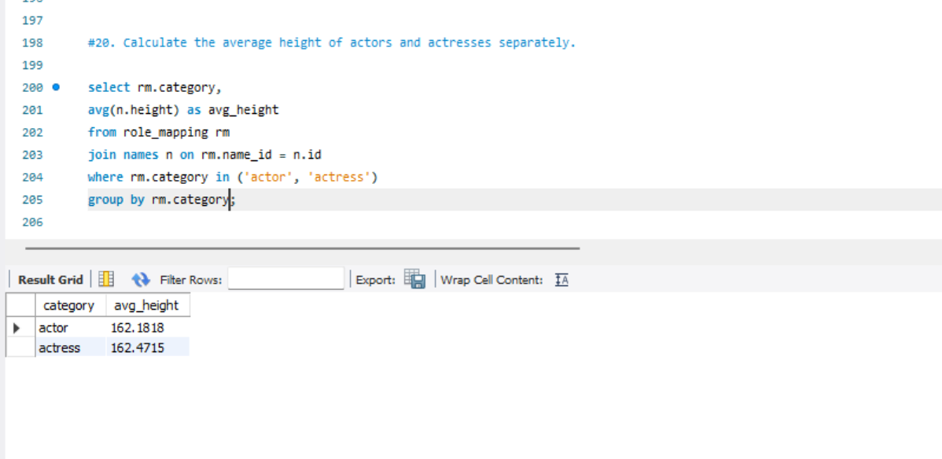
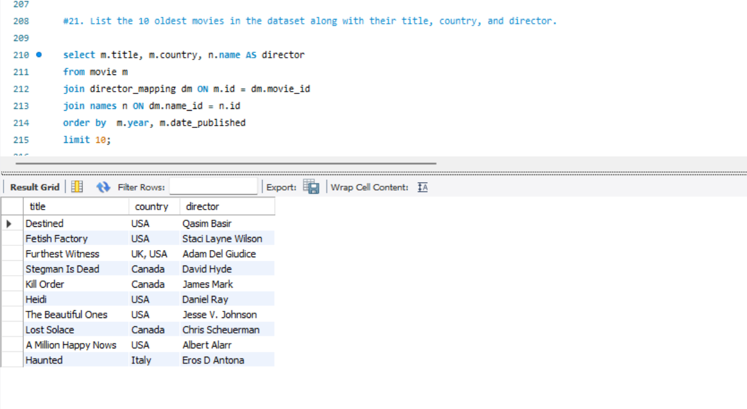
5.1.Talent and Production Analysis
The average height of actors and actresses separately.
The 10 oldest movies
Recognize top talent and production companies for future collaborations.

Slide 11
5.1.Talent and Production Analysis
The average height of actors and actresses separately.
The 10 oldest movies
Recognize top talent and production companies for future collaborations.

Slide 12
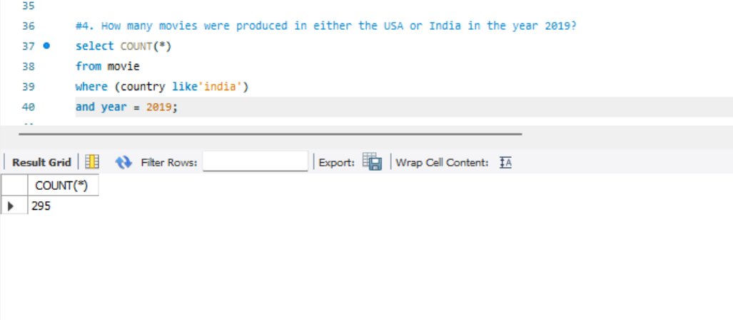
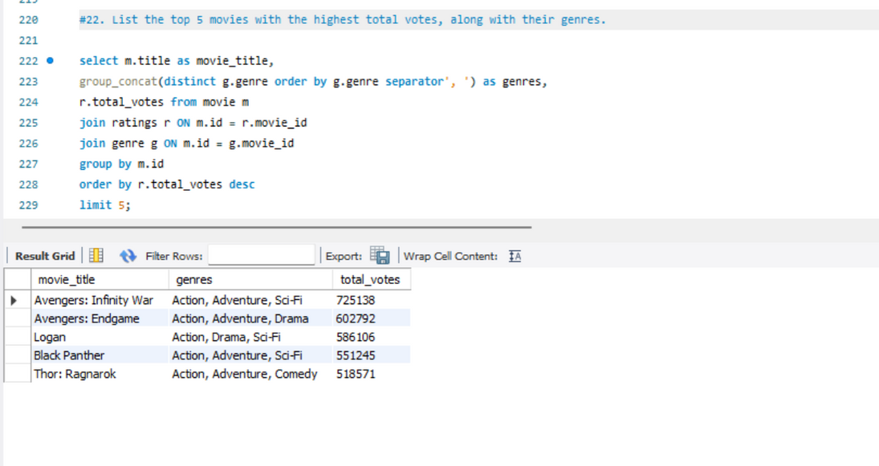
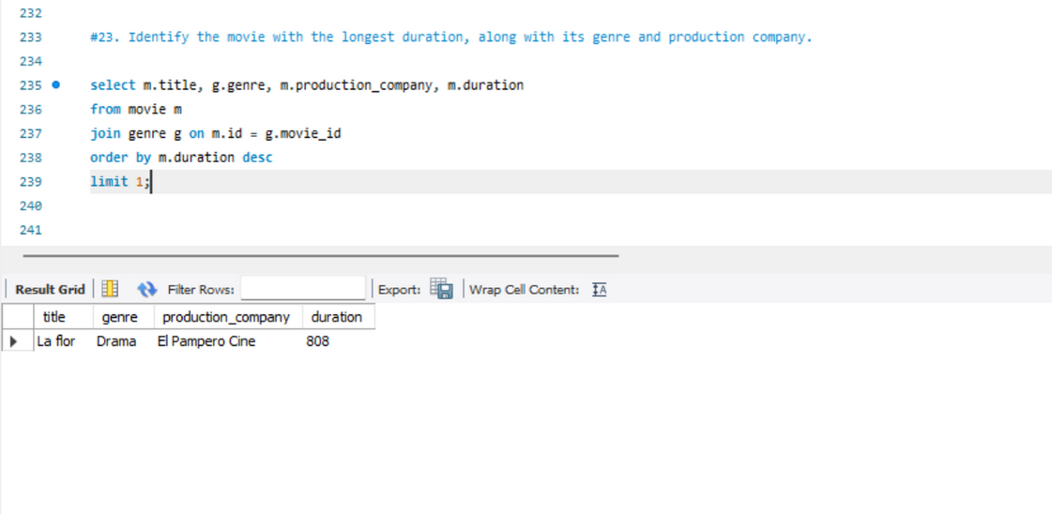
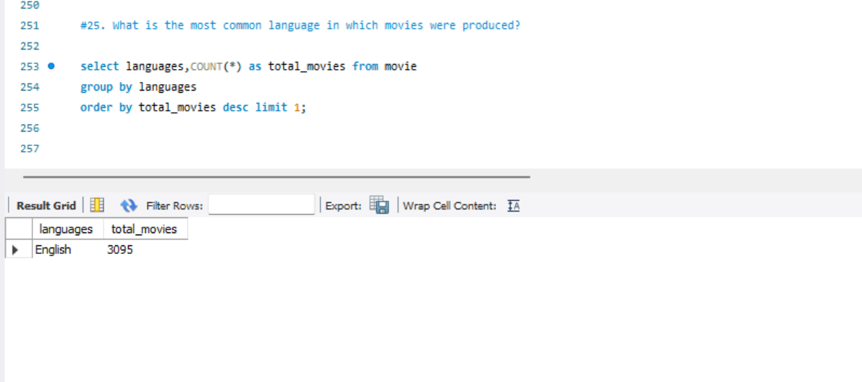
6. Movie Attributes and Metadata
Movies produced in the USA or India in 2019.
Top 5 movies with the highest total votes, along with their genres.
The movie with the longest duration
The most common language

Slide 13


INSIGHTS
The most popular Genre - Drama.
Highest-rated movies - Kirket & Love in Kilnerry
Top production companies by votes - Marvel Studios
Add a subheading
Popular movies and their genres - Avengers Infinity War
The dominant language - English
The longest duration Movie - La flor (808 min)

